Slide 1
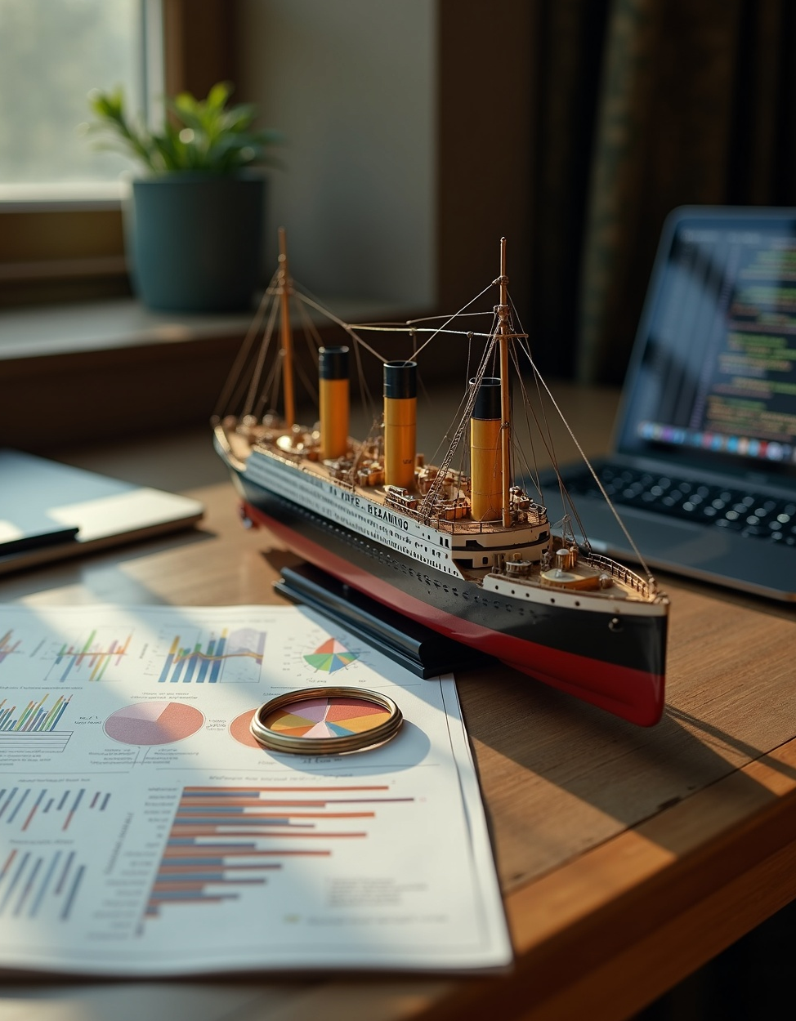
Titanic ML
Survival Prediction Using Machine Learning
By Magesh J
13.11.2025

Slide 2

Introduction
This presentation covers the Titanic Survival Prediction project using machine learning techniques. We will review the projects goals, dataset details, preprocessing steps, model selection, training, evaluation, and key insights about survival probabilities based on passenger features.

Slide 3

01
Titanic Survival Prediction

Slide 4
Project Overview and
Objective
The project aims to build a machine learning model to predict passenger survival on the Titanic. By analyzing historical data, the objective is to identify important factors affecting survival chances and provide accurate predictions using classification algorithms such as Random Forest, Logistic Regression, and Decision Trees.

Slide 5

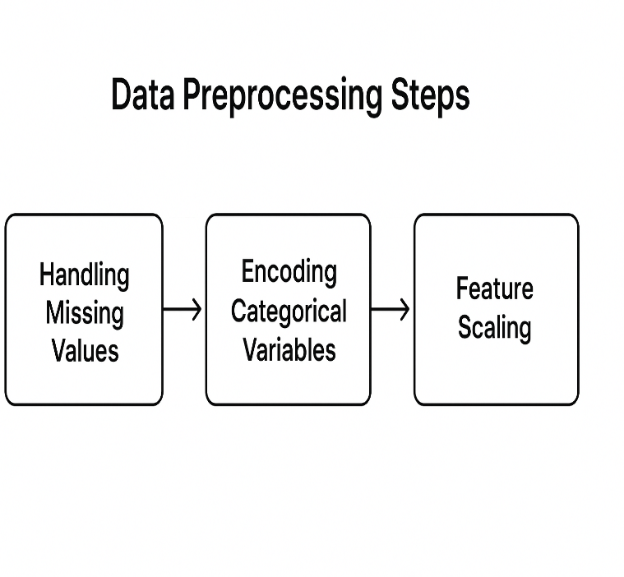
Dataset Description and Preprocessing
The project utilizes the Titanic dataset from Kaggle, containing passenger demographics and survival labels. Preprocessing involved handling missing values, encoding categorical variables, and scaling features to prepare data for effective model training and improved prediction performance.

Slide 6
Model Selection and
Training
To predict survival, models such as Random Forest, Logistic Regression, and Decision Trees were evaluated. Each model was trained on the preprocessed dataset, with performance measured by accuracy and F1-score. The Random Forest model showed strong predictive capability, balancing precision and recall, making it the preferred choice for detailed survival analysis and interpretation of key features.

Slide 7

02
Document Summarizer App
Build and Deployed using hugging face

Slide 8

Introduction and Project Objective
The project focuses on developing an AI-powered document summarizer that automates the extraction of concise summaries from lengthy texts. The objective is to save time and improve information retrieval by leveraging state-of-the-art natural language processing techniques to generate accurate and coherent summaries tailored for various professional and personal use cases.

Slide 9
Technologies and Model
Used
This application utilizes Python with Hugging Face Transformers and Gradio for an interactive interface. The core model options include BART-large-CNN and T5-small, both known for efficient and high-quality summarization. These technologies together enable seamless integration of powerful NLP models with user-friendly deployment for real-time document summarization.

Slide 10
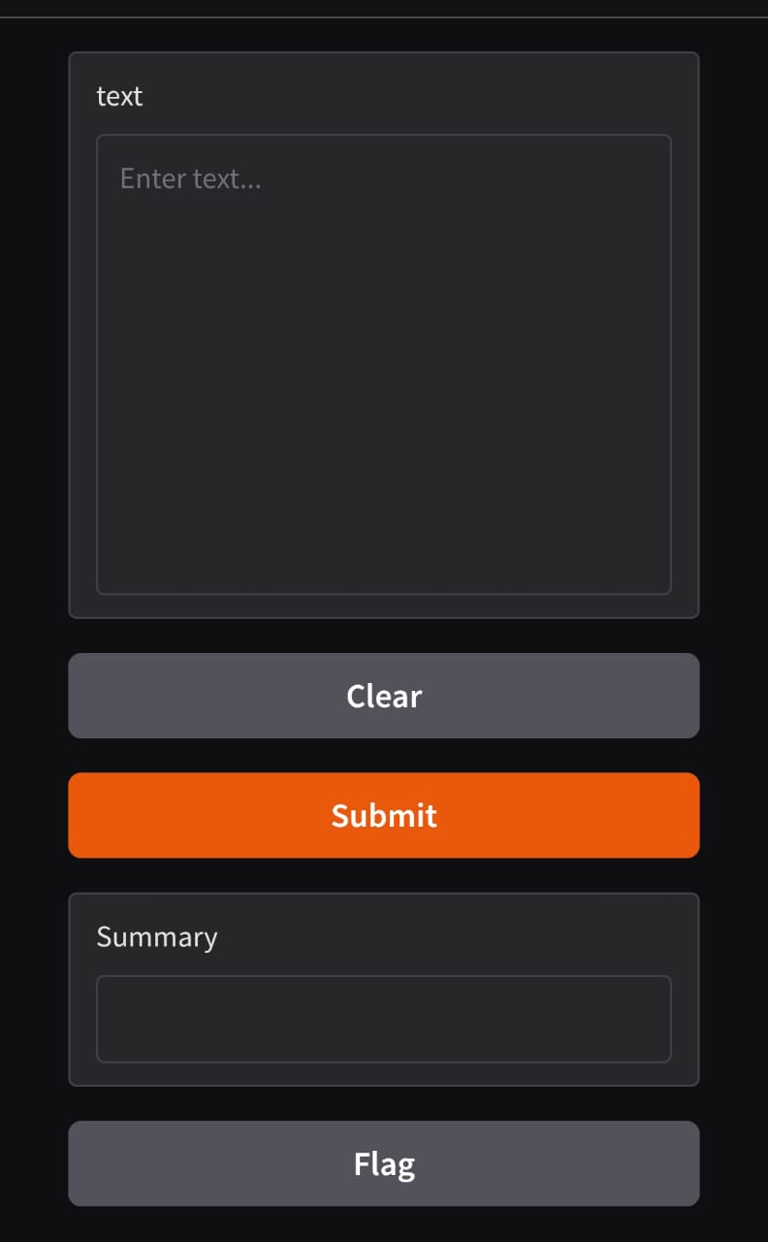
Working Process and Application
Demo
The summarization workflow involves user inputting a document, which the model processes to produce a concise summary. The Gradio web app interface demonstrates this process live, showing how the model translates long text into brief, informative summaries. This intuitive setup ensures accessibility and usability for users with varied technical backgrounds.

Slide 11
Conclusions
The Titanic Survival Prediction project highlights the effectiveness of machine learning in understanding historical data and predicting outcomes with high accuracy. Meanwhile, the Document Summarizer App showcases the potential of NLP to enhance productivity through automated text summarization. Future work will explore improvements in both model performance and user experience to maximize real-world impact.

